Slide 2
Year End Evaluation Timeline
December 7th – 11th Department Increase Spreadsheets sent to Elected Officials/Department Directors.
December 21st Department Increase Spreadsheets due back to HR for approval. (Send to Sarah and Cari)
December 24th HR will have approved and sent back Department Increase Spreadsheets.

Slide 3
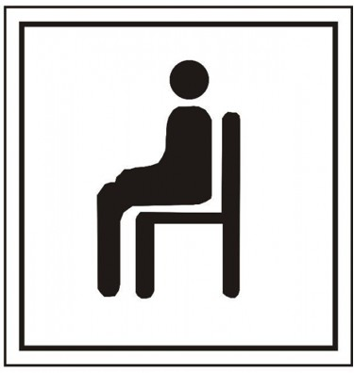
December 28th – December 31st Sit down with employees to review evaluations and give pay increase amount.
By January 7th HR will verify that all employees have an evaluation in MUNIS to receive P4P raise.

Slide 4
MUNIS/Payroll Timeline
MUNIS Blackout: January 8th, 2021 to January 21st, 2021
Time for January 15th payday MUST be entered by
no later than January 7th.
New raises will be seen on January 29th checks
(One-Time Bonus will be ran on separate payroll)

Slide 5
2020 Performance Rating | 2020 Merit Increase 2% Budget* | 2020 Lump Sum Merit Payment 1% Budget**
5: Excellent | 3% | Discretionary
4: Impressive | 2.5% | Discretionary
3: Solid | 2% | Discretionary
2: Focus Needed | 1%-1.5% | Discretionary
1: Unsatisfactory | 0% | Discretionary
Probationary Period | 0% (Increase given at the end of probationary period) | 0%
1st Year Employees | Prorated based on when they received increase (i.e. if probation ended in July they are eligible for ½ normal amount). | Discretionary
*For employees whose current pay is within their pay range, including those who may reach the top of their pay range and become eligible for the remaining portion to be paid to them as a lump sum.
**For employees who deserve extra recognition for achievements.

Slide 6
Change in Supervision:
 | Weeks of Supervision | Appraisal Score | Total
Supervisor A | 22 | 4.12 | 90.64
Supervisor B | 30 | 3.75 | 112.5
 |  |  | 203.14
203.14/52 weeks = 3.90

Slide 7
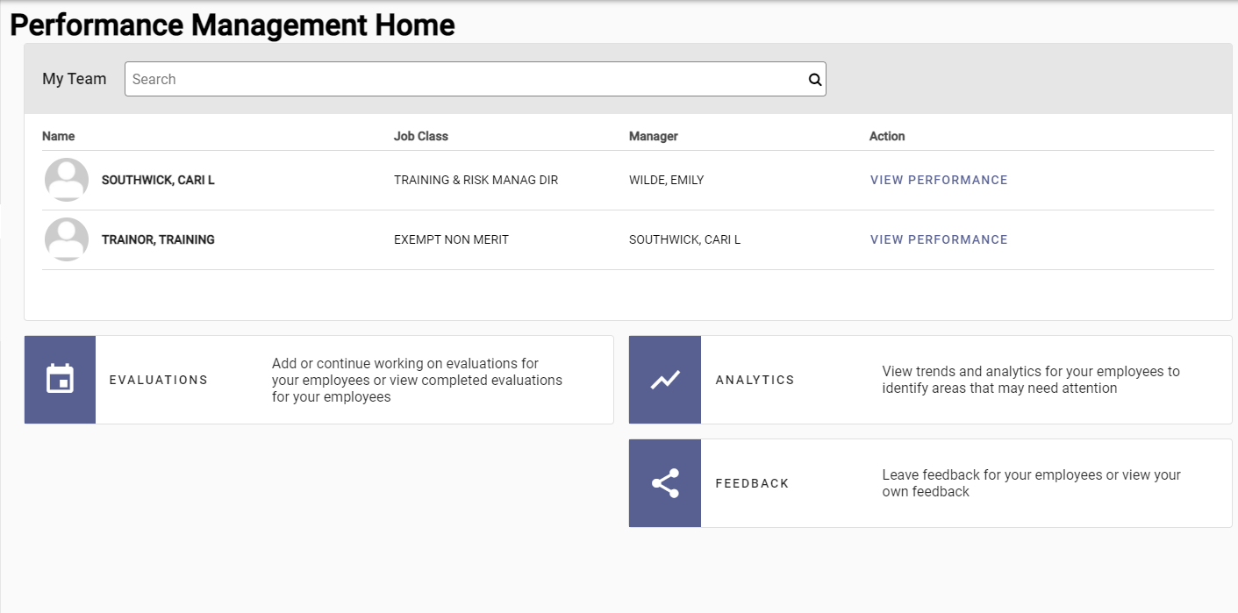
On the Performance Management Home page, click Evaluations to add an evaluation to your employee.

Slide 8
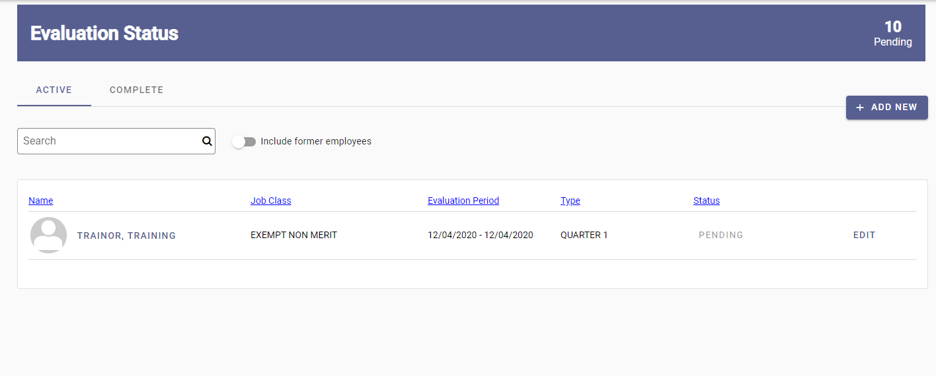
A list of your employees will appear.
Select which employee you want to add an evaluation for.

Slide 9
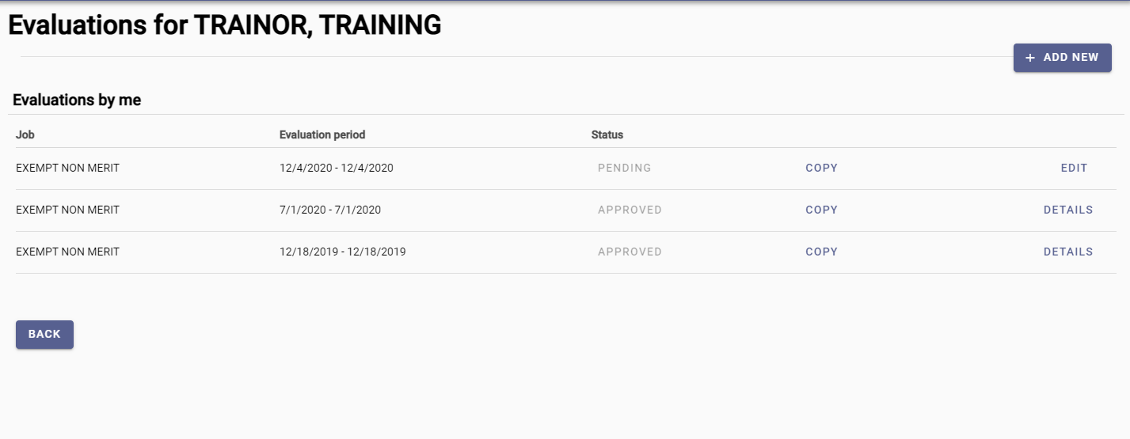
Once you have selected the employee, click the “Add New” button.

Slide 10
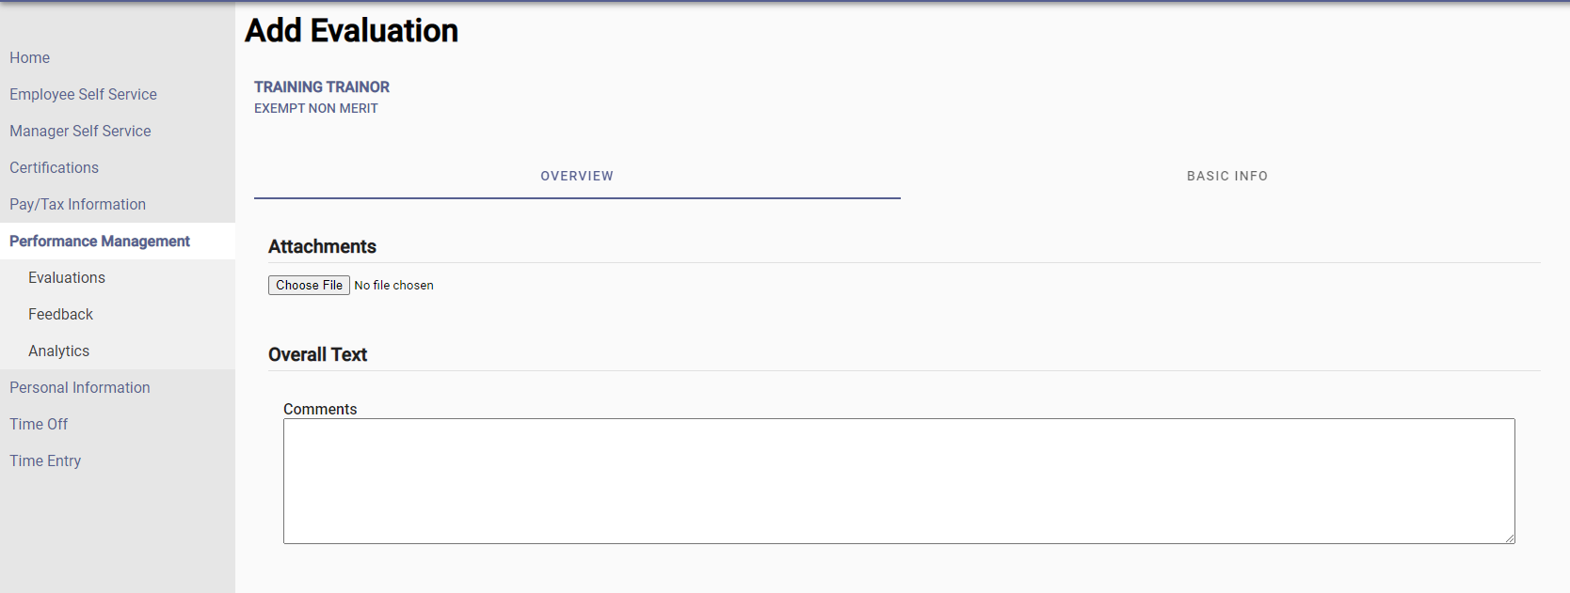
Attach the employees evaluation.
Select Basic Info.

Slide 11
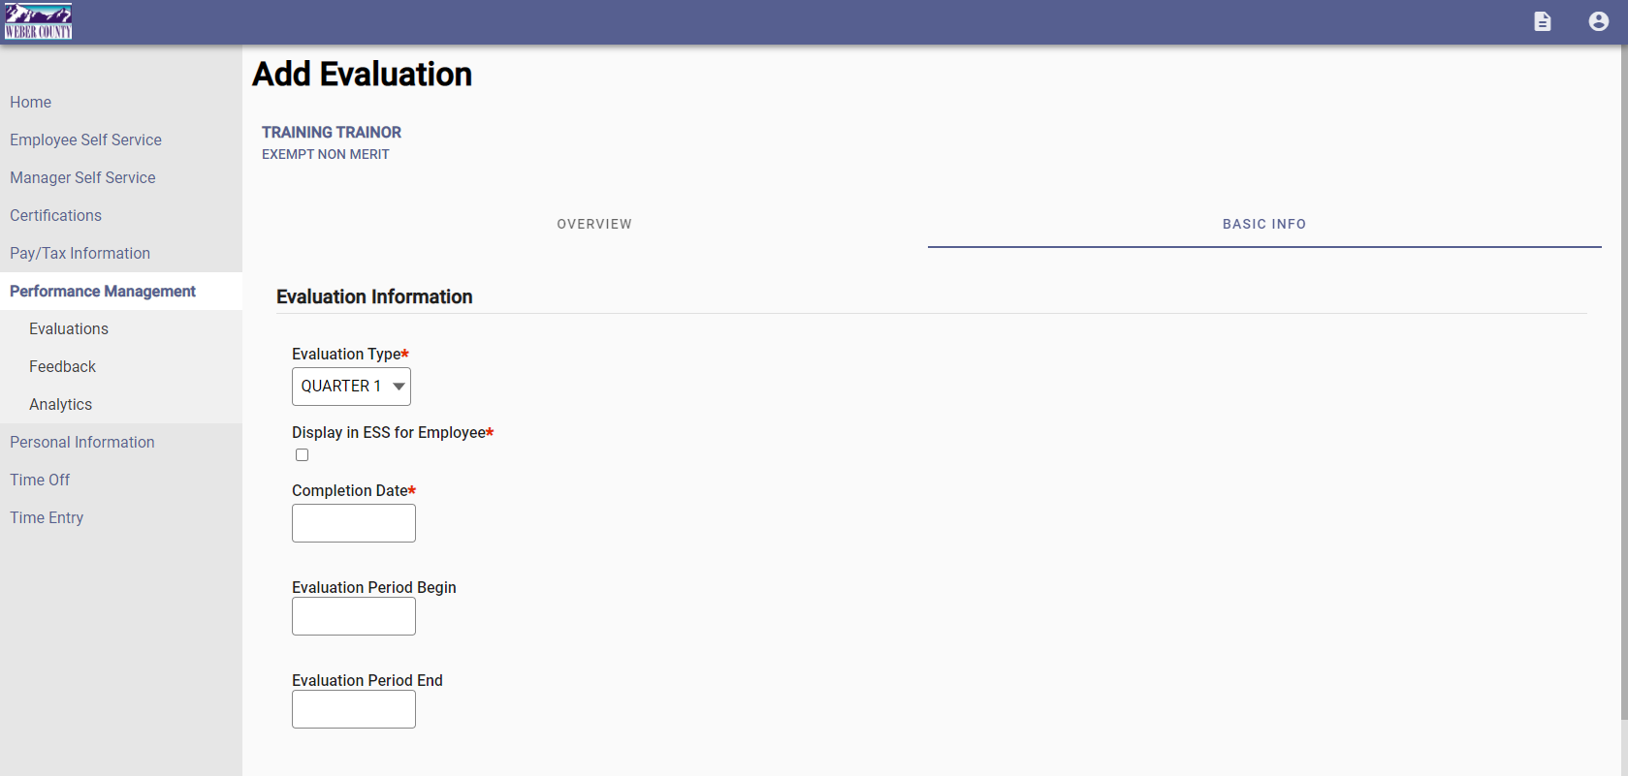
Evaluation Type: Quarter 4
Display in ESS:
Completion Date: The day you present the evaluation to employee
Evaluation Period Begin: 01/01/2020
Evaluation Period End: 12/31/2020

Slide 12
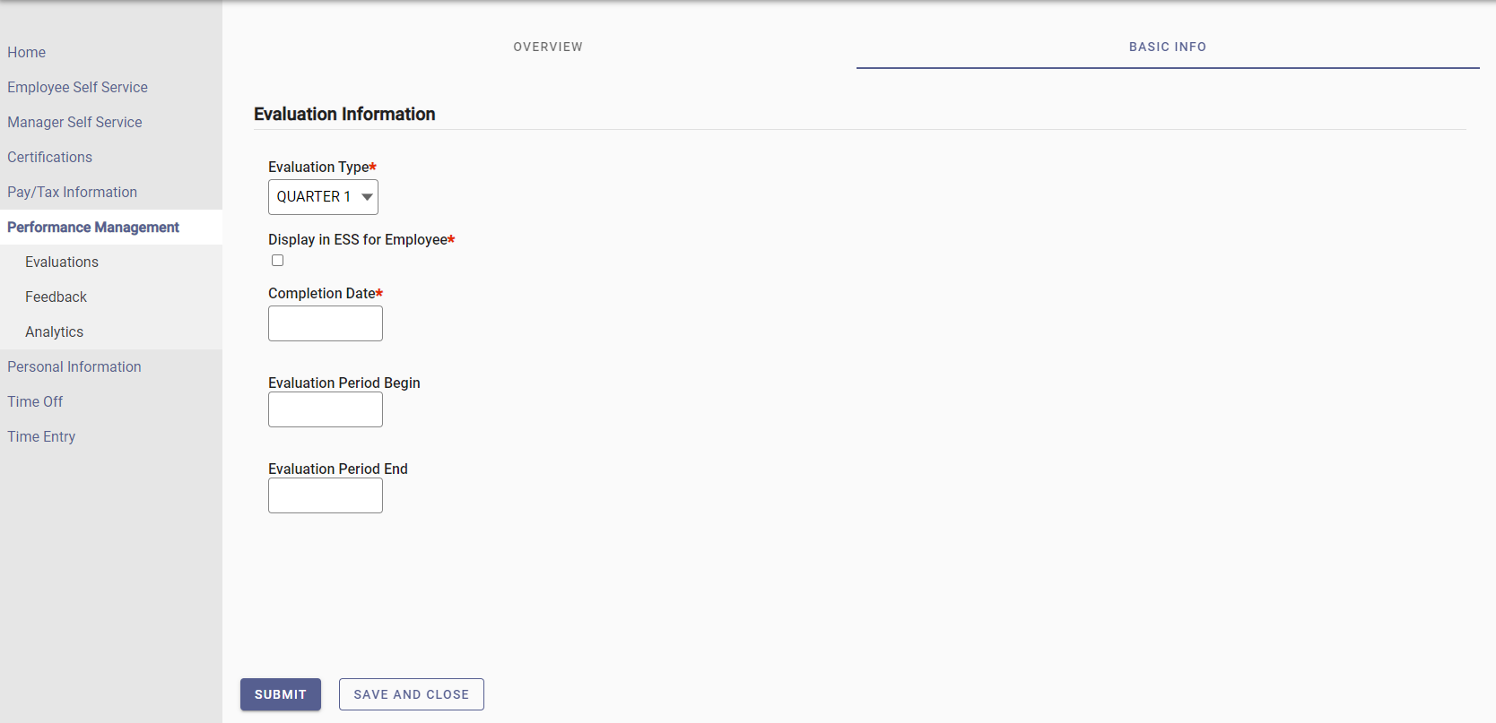
Once information has been entered, click Submit.
Save and Close will not go to employee for approval.

